Slide 1
The Integumentary System
Fancy word for skin

Slide 2
Function of Skin
Protection from infection and injury
Regulate body temperature
Removes waste products
Protection from UV

Slide 3
Three Layers of Skin
Epidermis
Dermis
Hypodermis

Slide 4
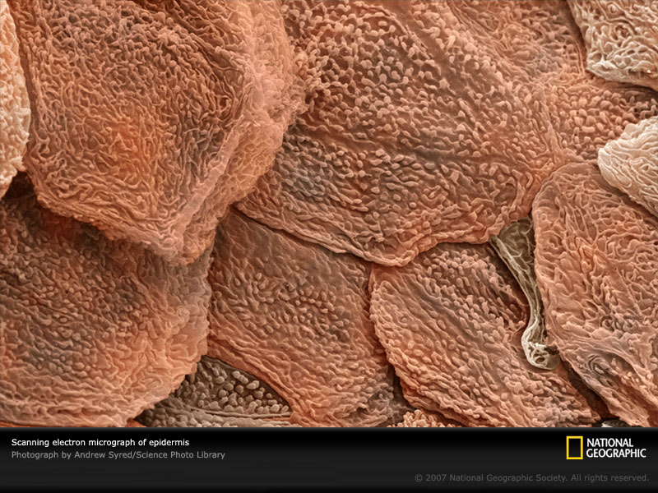
Epidermis
Outer layer of skin.
External portion is dead, keratin filled cells.
Internal portion is living, dividing cells

Slide 5
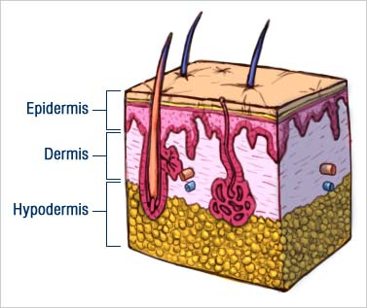
Epidermis
Keratin – tough, fibrous protein
Contains melanocytes
Produce melanin, a brown, black or yellow pigment.

Slide 6
Skin Cancer
Exposure to ultraviolet light can cause skin cancer
Melanoma – dangerous skin cancer affecting melanocytes
Wear protective clothing, a hat and sunglasses

Slide 7
Dermis
The layer of skin under the epidermis
Contains
Blood vessels
Nerves
Glands
Smooth Muscle
Hair follicles

Slide 8
Hair
Protects the body from dirt and other materials from entering the body.
Hair is produced by rapidly reproducing cells in the hair follicles.

Slide 9
Nails
The nail root is a rapidly growing area of cells that form a flat, thick plate.

Slide 10
Hypodermis
A layer of fat and connective tissue that lies immediately under the dermis

