Slide 1
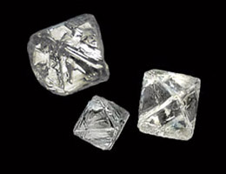
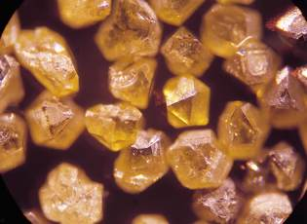
Looking for Diamonds
http://www.avure.com/iso/applications/industrial-diamonds.asp

Slide 2
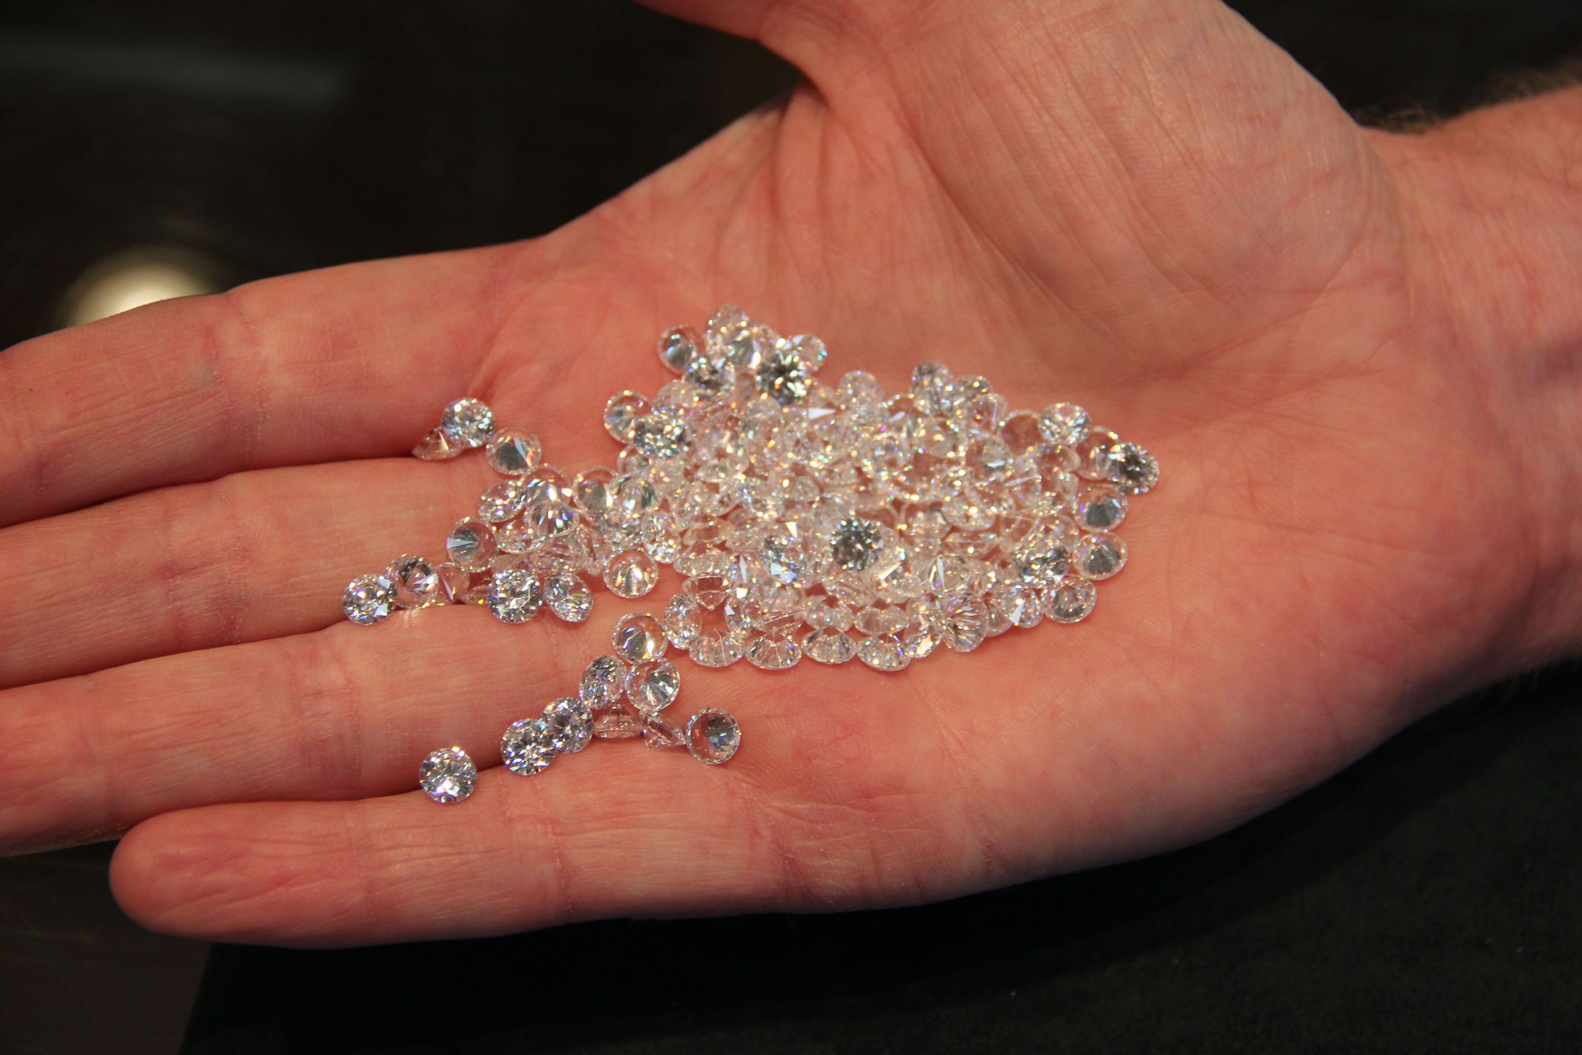

Slide 3
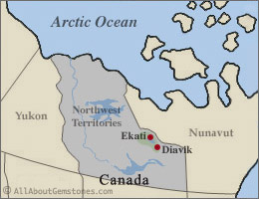
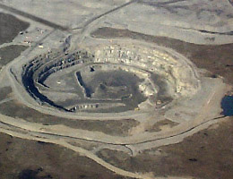
Diamond Mines in Canada
Ekati
http://www.allaboutgemstones.com/diamond_mines_canada.html
Notes:
Think rare! Not many per continent.

Slide 4
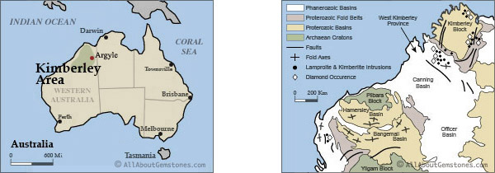
Diamond Mines in Australia

Slide 5
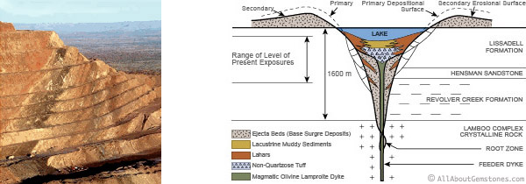
It’s a Volcano!

Slide 6
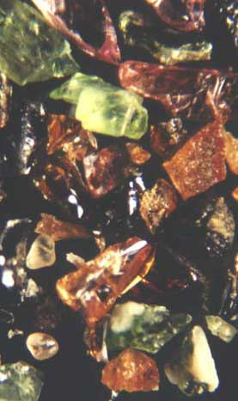
Indicator Minerals
“(Photo: concentrated heavies from gravel sometimes contain garnet (orange), pyroxene (green), ilmenites (black),magnification X 200.)”
“Picking kimberlitic indicators and diamond indicators is based on colour. Colour results from Fe, Mn, Cr content. Pyrope - pinkish red, crimson to purple; Chrome-Pyrope greenish violet to purplish. Almandine; deep red to brown-black. Grossular; colourless, pink, yellow-green depending on Fe and Mn present.(Deer,1993) Picking based on colour takes experience and a good eye for variations in colour. It is a difficult, subjective and inexact process. DIMs are .25 to 2 or 3 millimeters, so you need good eyes and a good microscope.”
http://www.landandminerals.com/diamond_indicators.html

Slide 7
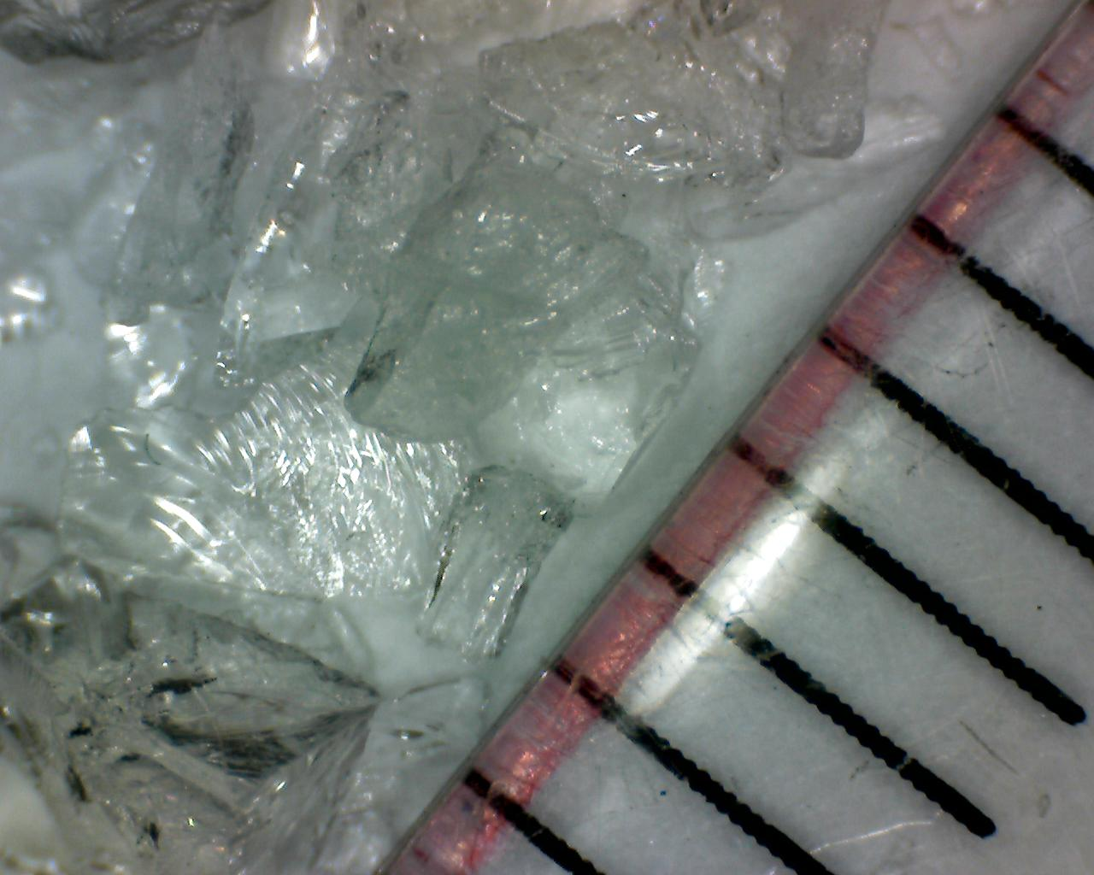
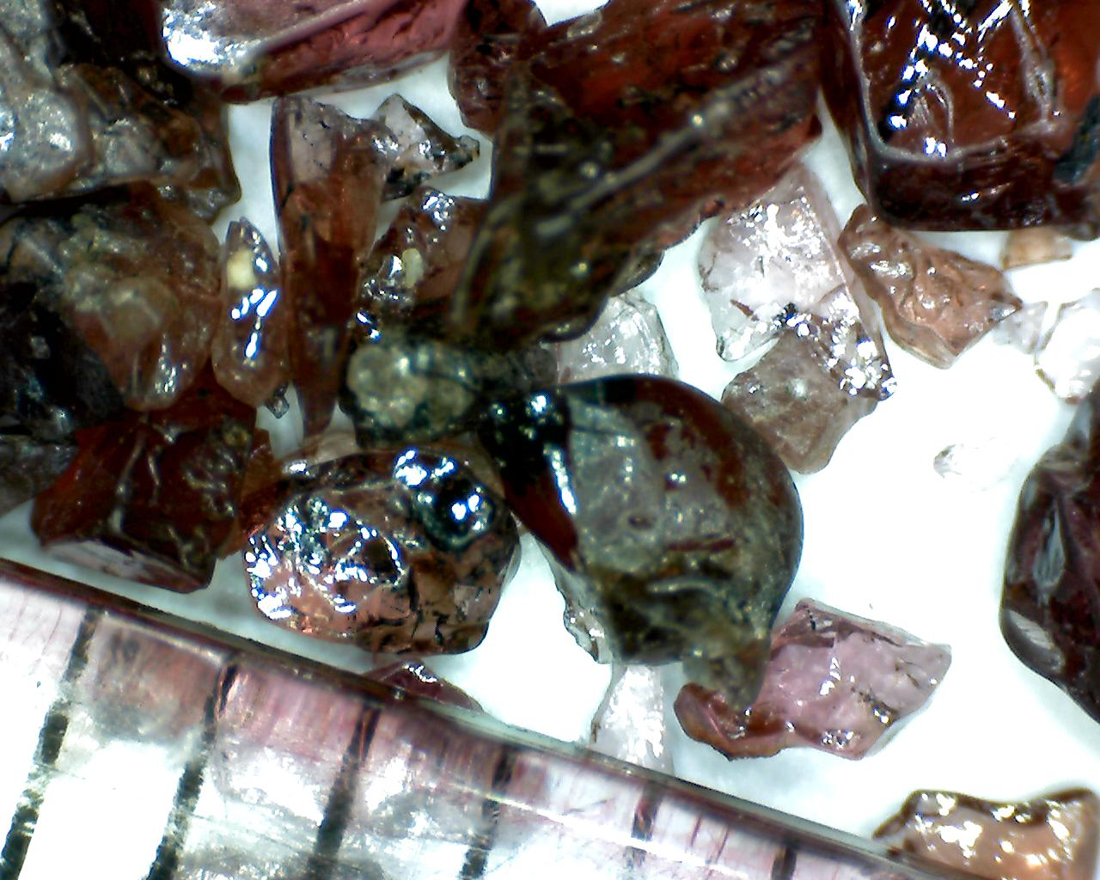
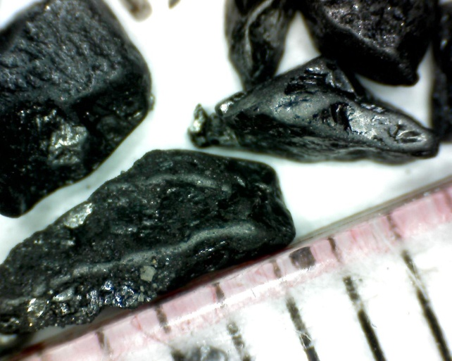
Mineral Properties
Color
Red, green, black, …
Colorless
Luster
Glassy
Metallic

Slide 8
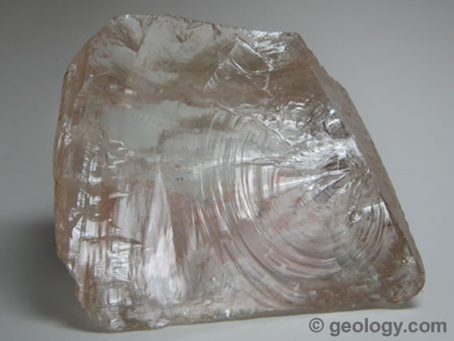
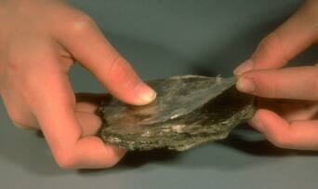
Mineral Properties
Cleavage
Fracture

Slide 9
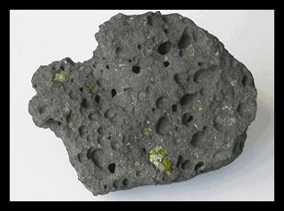
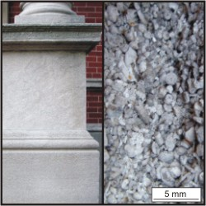
Rock Fragments
basalt
limestone
http://mail.ab.mec.edu/~mdoiron/homework
http://academic.brooklyn.cuny.edu/geology/powell/613webpage/N
YCbuilding/IndianaLimestone/IndianaLimestone.htm

Slide 10
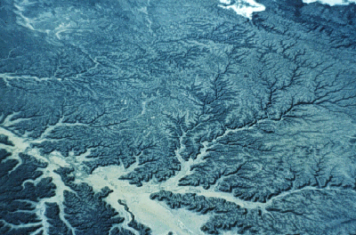
Reading the Map
http://golearngeo.wordpress.com/new-post/?page=stats&view=post&post=200&blog=12122768
http://resweb.llu.edu/rford/courses/essc500/fluvial/fluvial.html
Notes:
rocks erode, minerals and rock fragments get washed down stream

Slide 11
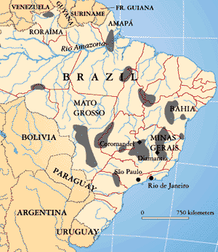
Use Rivers to Find Diamond Deposits
This map shows that diamond deposits are widely distributed in Brazil. The shaded areas are diamond deposits.
http://www.amnh.org/exhibitions/diamonds/brazil.html

Slide 12
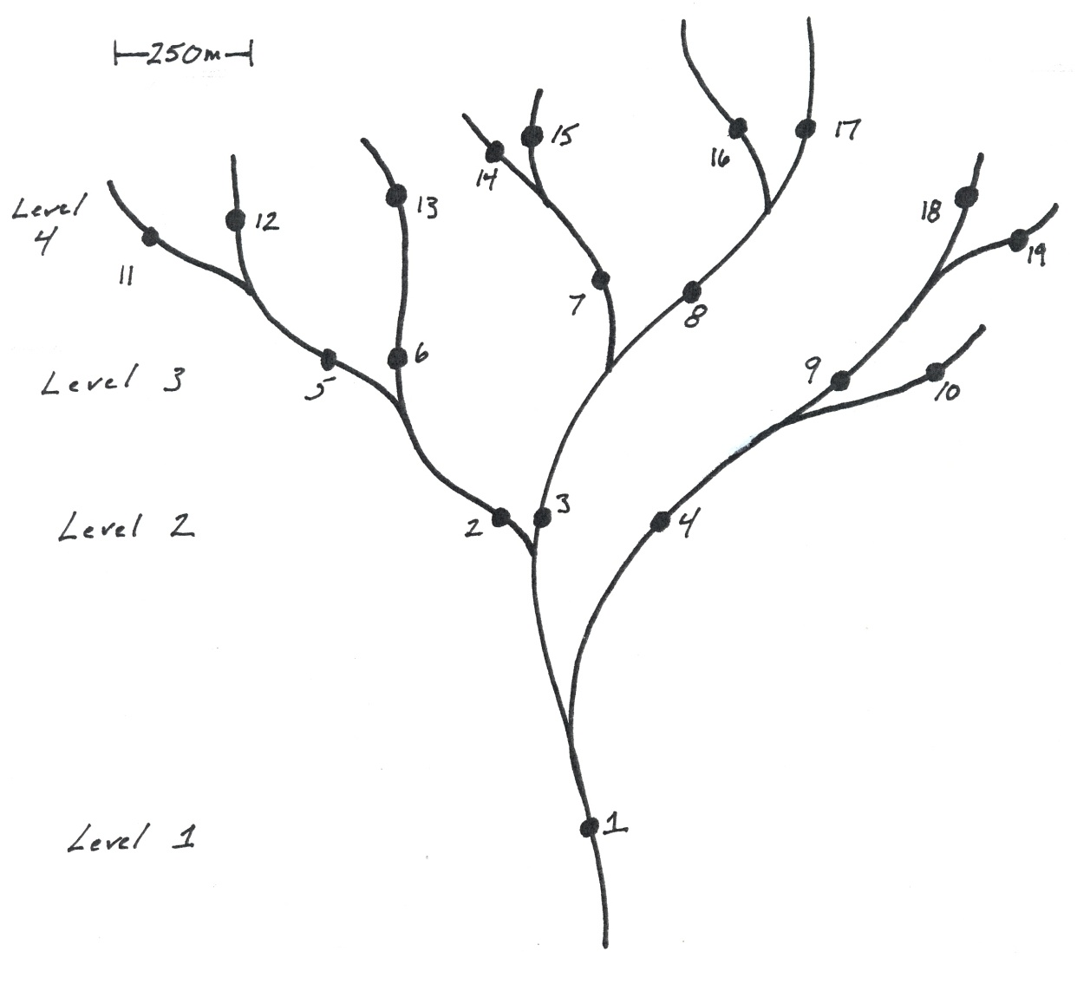
Your River Map & Guidelines

Slide 13
Careful, the next few pages have all the answers.

Slide 14
Rocks and Minerals at Locations
Sample/ Loc | Diamond | Diopside | Garnet | Ilmenite | K-feldspar | Olivine | Phlogopite | Quartz | Basalt | Limestone
1 |  | 1 |  |  | 1 |  |  | 1 | 5 | 2
2 |  |  |  |  | 3 |  |  | 4 | 3
3 |  |  |  | 1 | 1 | 1 |  |  | 3 | 4
4 |  |  |  |  |  |  |  |  | 3 | 7
5 |  |  |  |  | 7 |  |  | 3
6 |  |  |  |  | 5 |  |  | 5
7 |  |  |  |  | 2 |  |  | 3 | 3 | 2
8 |  | 1 | 1 | 1 |  | 1 | 1 |  |  | 5
9 |  |  |  |  |  |  |  |  |  | 10
10 |  |  |  |  |  |  |  |  |  | 10
11 |  |  |  |  | 4 |  |  | 6
12 |  |  |  |  | 8 |  |  | 2
13 |  |  |  |  | 5 |  |  | 5
14 |  |  |  |  | 9 |  |  | 1
15 |  |  |  |  | 3 |  |  | 7
16 | 1 | 2 | 3 |  |  | 1 | 2 |  |  | 1
17 |  |  |  |  |  |  |  |  |  | 10
18 |  |  |  |  |  |  |  |  |  | 10
19 |  |  |  |  |  |  |  |  |  | 10

Slide 15
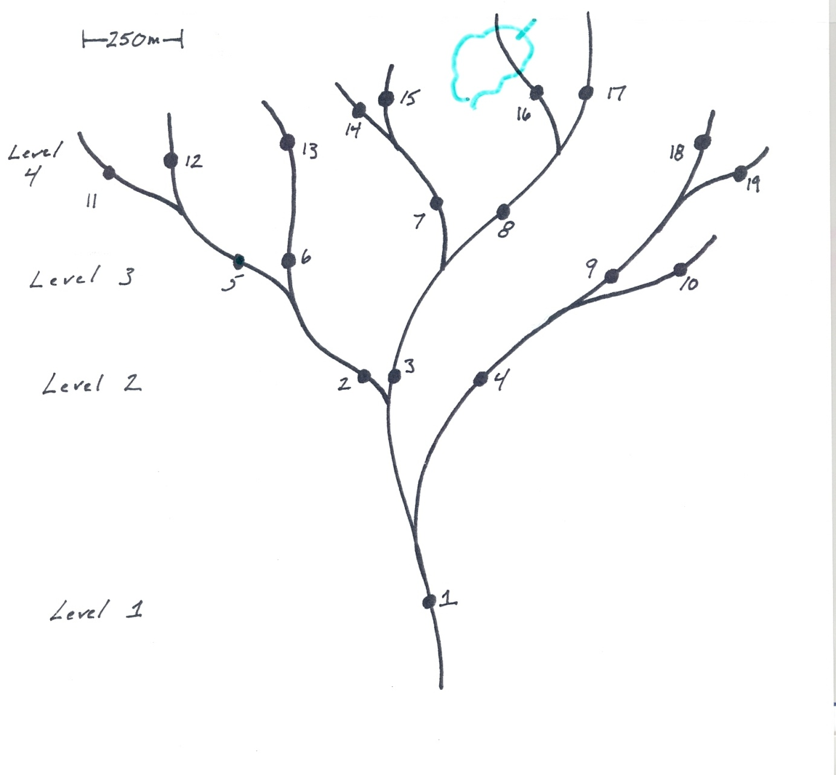
Location of Diamond Deposit

Slide 16
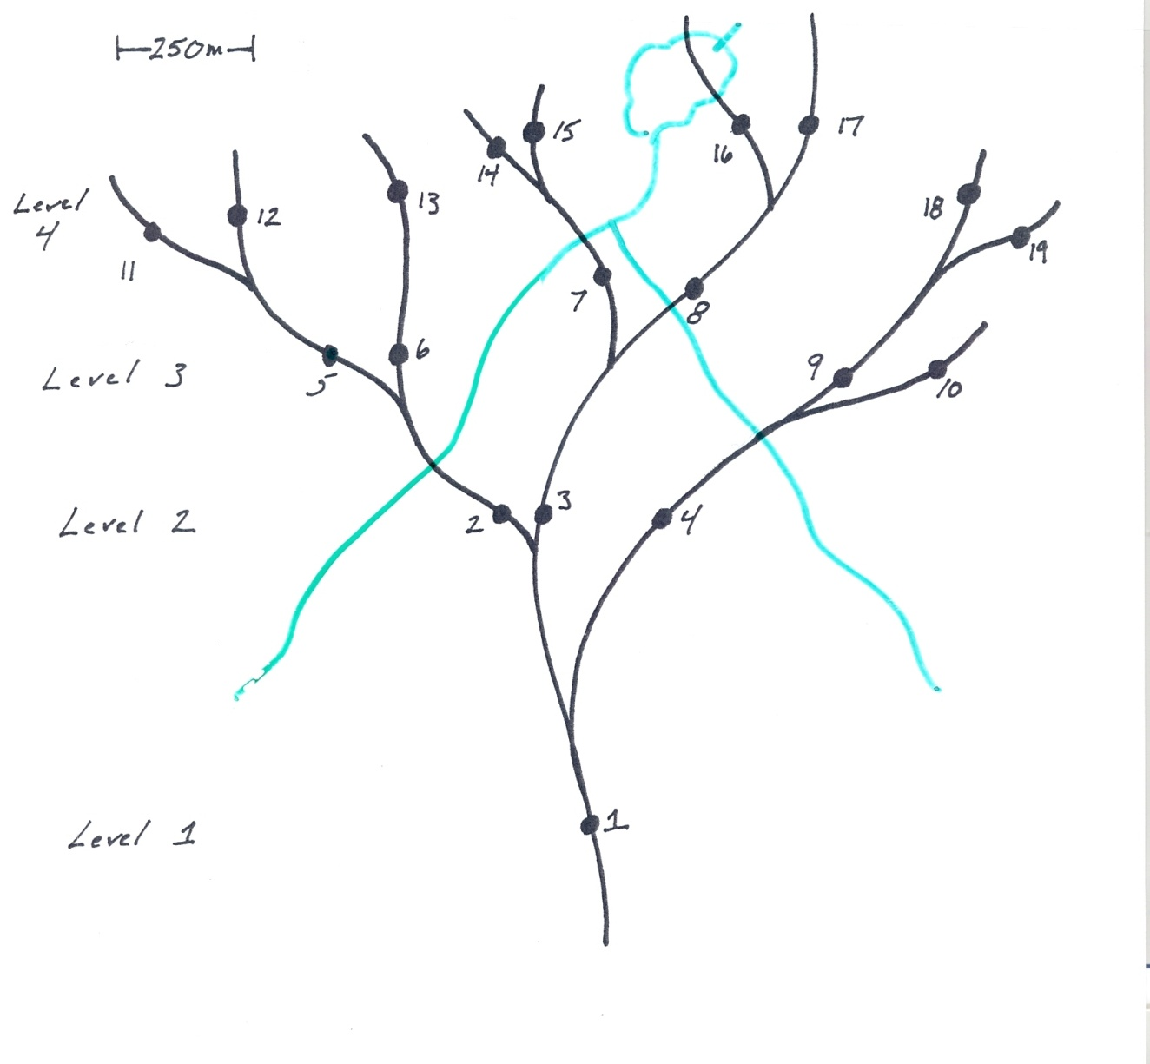
Possible Geologic Map

Slide 17
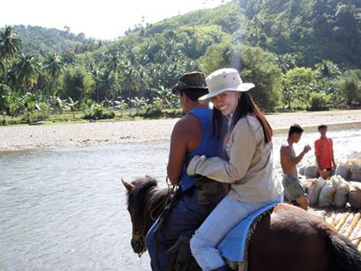
Congratulations! You could be a geologist.
Above, Kate Digdigan on horsback at a river crossing in Linay, a village near
Canatuan in Siocon, Zamboanga del Norte where TVIRD is undertaking its
Greater Canatuan exploration activities.
http://www.tviphilippines.com/article.php?id=234

Slide 18
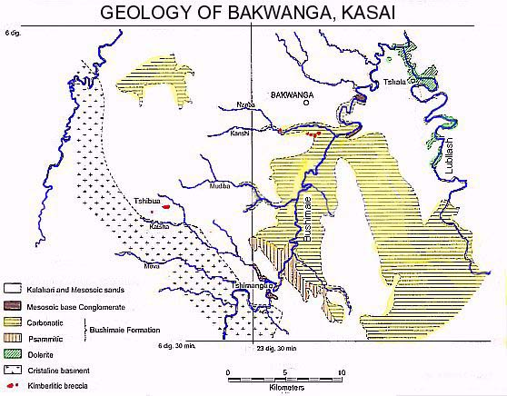
Use Rivers to Find Diamond Deposits
http://www.africafederation.net/Kasai_Diamonds.htm

